Slide 1
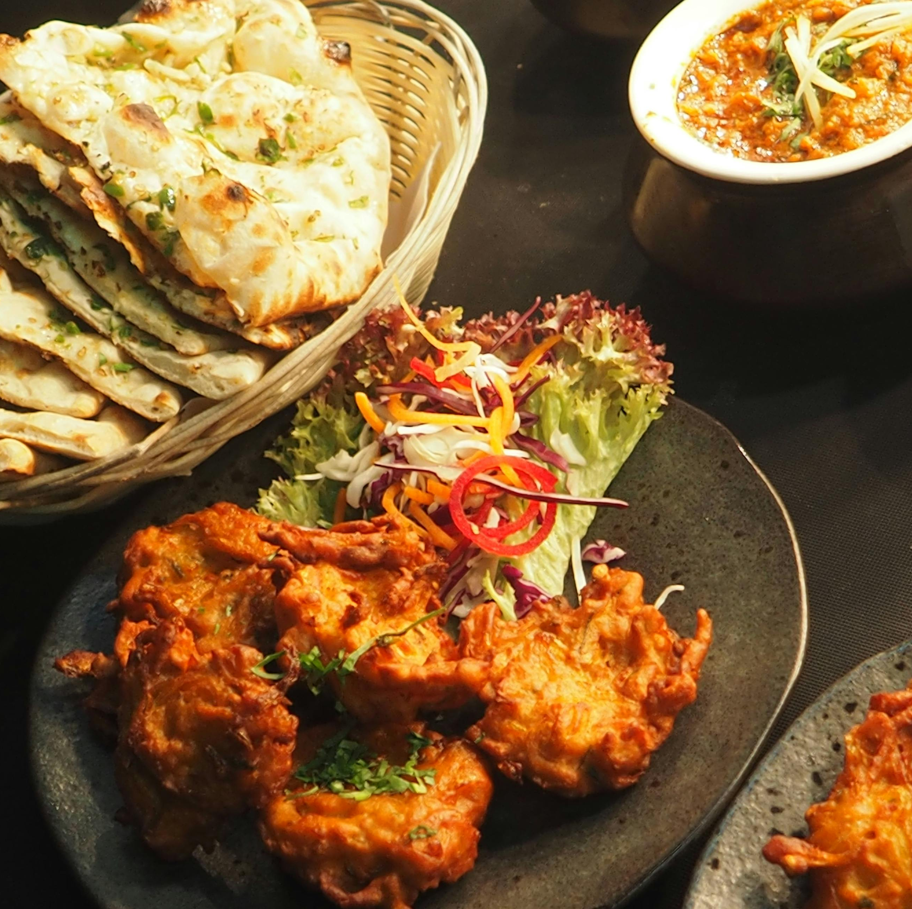
Group I Project Progress Scrum/Check In
Deran Cross, Zifran Chowdhury, Ikechukwu Ogowuihe, Emmanuel Dairo

Slide 2
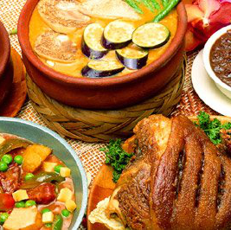
Kitchen Sync
ThePhoto by PhotoAuthor is licensed under CCYYSA.

Slide 3
Project Status
Current Project Status: Yellow
The frontend is mostly done, backend is still in progress
Activities to be achieved next week
Backend development which includes:
Delivering envisioned MVPs
Add Database
Implement API for food suggestion

Slide 4

Work-in Progress Demo

Slide 5
Self-Reflection
How did we feel about this activity?
The project was overwhelming initially but breaking it into smaller components (MVC framework) helped us to become more confident.
Stuck to a progression similar to the one in the lab
It brought about more team collaboration
What did we like about it?
The practical work was informative.
What did we dislike about it?
Collaborating while coding can be messy

Slide 6
Self-Reflection Continued
What did we learn about yourself as we collaborated and worked on this activity?
We learned that listening to others’ ideas leads to better results.
We realized we are good at problem-solving and staying focused under pressure.
How will you use (or not use) what you have learned/experienced in this activity going forward?
We'll be more confident tackling unfamiliar problems
What "stuff & things" related to this activity would you like more help with?
'Ingredient Matching' logic
Recommendations on what to buy – out of scope?

Slide 7


